Slide 1
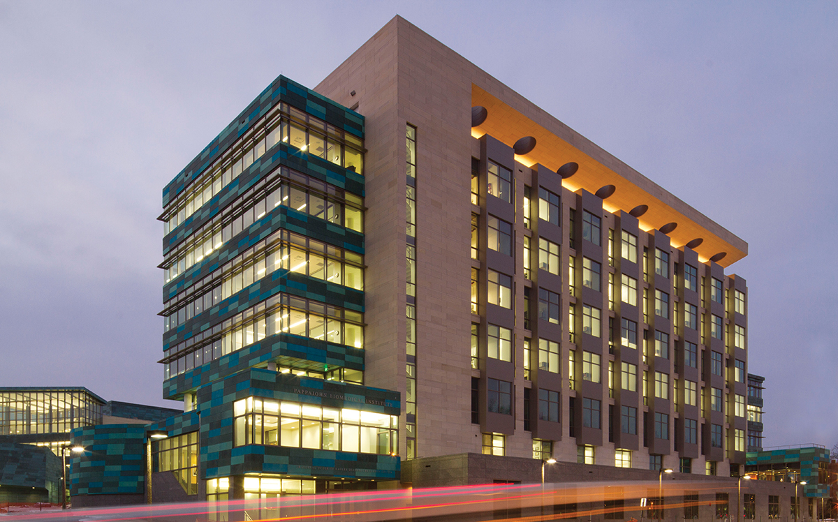
MRS
Vincent A. Magnotta, PhD
Professor, Radiology
Director, MR Research Facility
October 16, 2019

Slide 2
Imaging Methods to Assess Metabolism
MR Spectroscopy
¹H MRS
³¹P MRS
Proton Exchange
CEST - Chemical Exchange Saturation Transfer
T1ρ - T1 relaxation in the rotating frame
MR contrast agents
PARACEST Agents
Gd
Pros / Cons
MRS techniques specific and contain a number of metabolites
MRS typically low resolution since signal 10⁴ – 10⁵ weaker than water signal

Slide 3
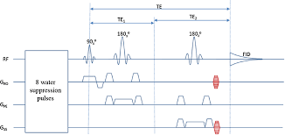
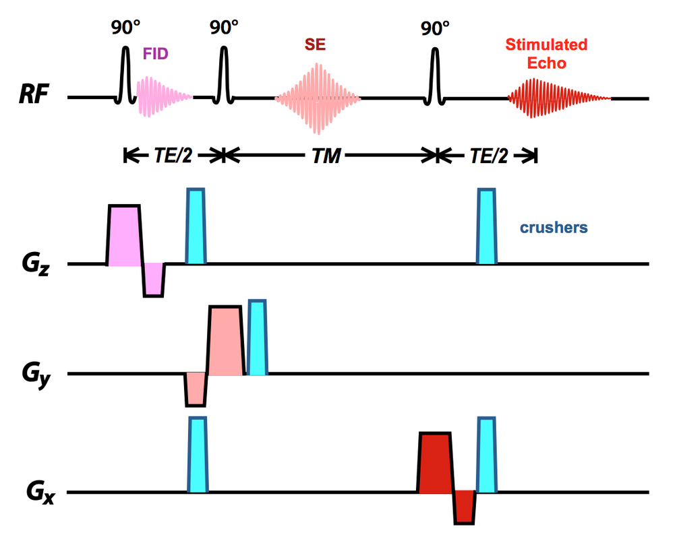
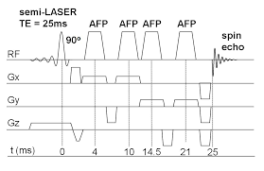
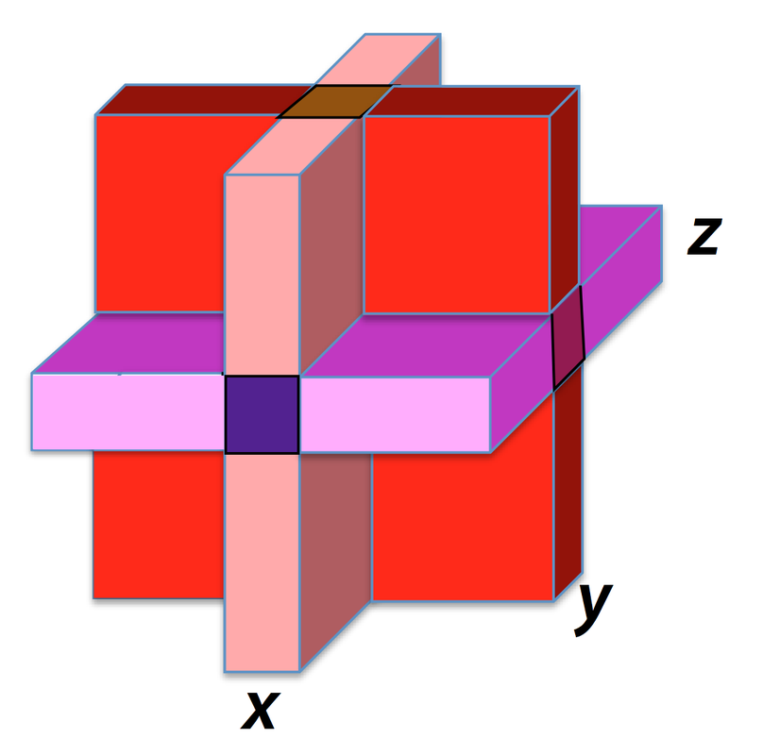
MRS Sequences
STEAM
PRESS

Slide 4
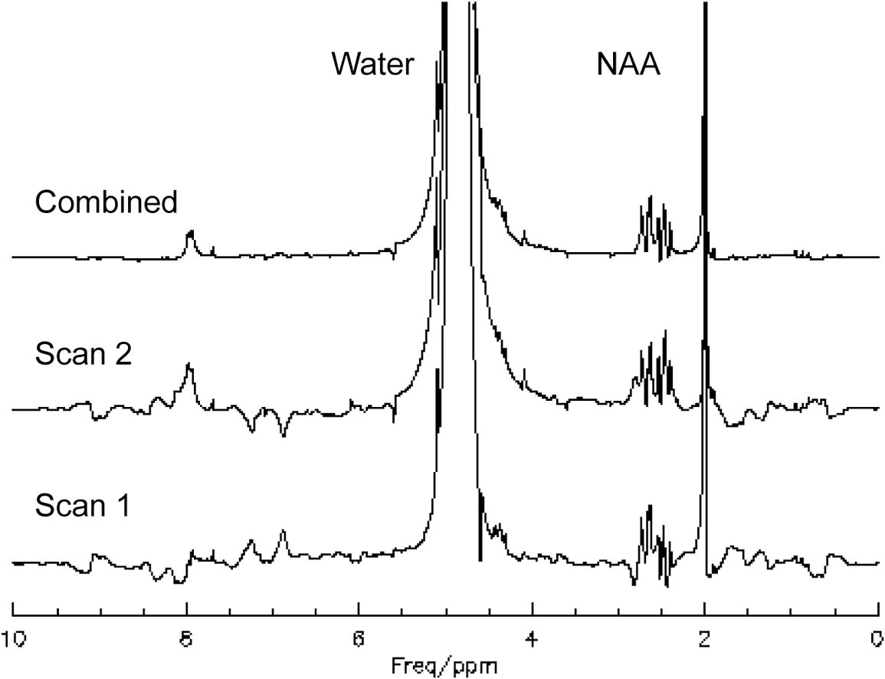
MRS Spectrum

Slide 5
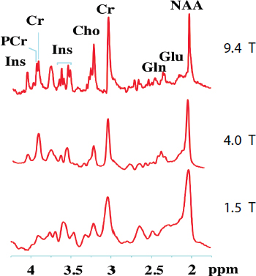
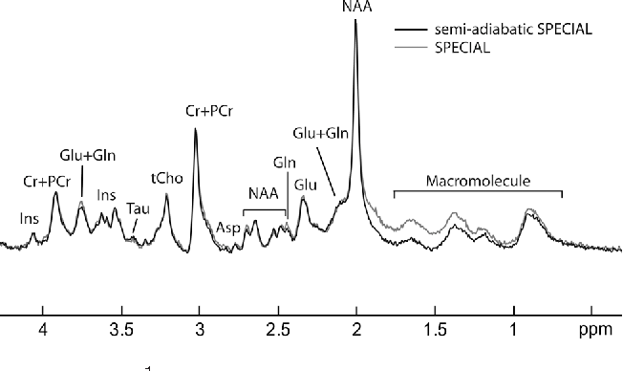
Metabolites Visible

Slide 6
Water Suppression
Minimize water signal
CHESS
MOIST
VAPOR
WET

Slide 7
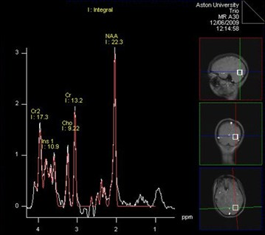
Proton MRS

Slide 8
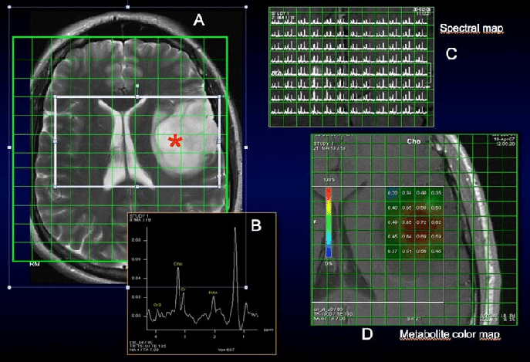
Chemical Shift Imaging

Slide 9
¹H Visible Metabolites
NAA - neuronal and axonal integrity
Creatine & phosphocratine– brain energy metabolism
Choline - membrane turnover / cell division
Lactate – indicator of glycolosis
Tau - modulation of calcium, osmoregulation and membrane stabilization
Myo-inositol - role in structural basis
Glutamate
Glutamine
Lipids
Creb Cycle

Slide 10
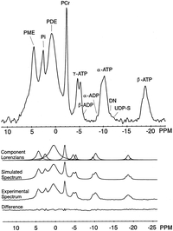
³¹P Spectrum Example

Slide 11
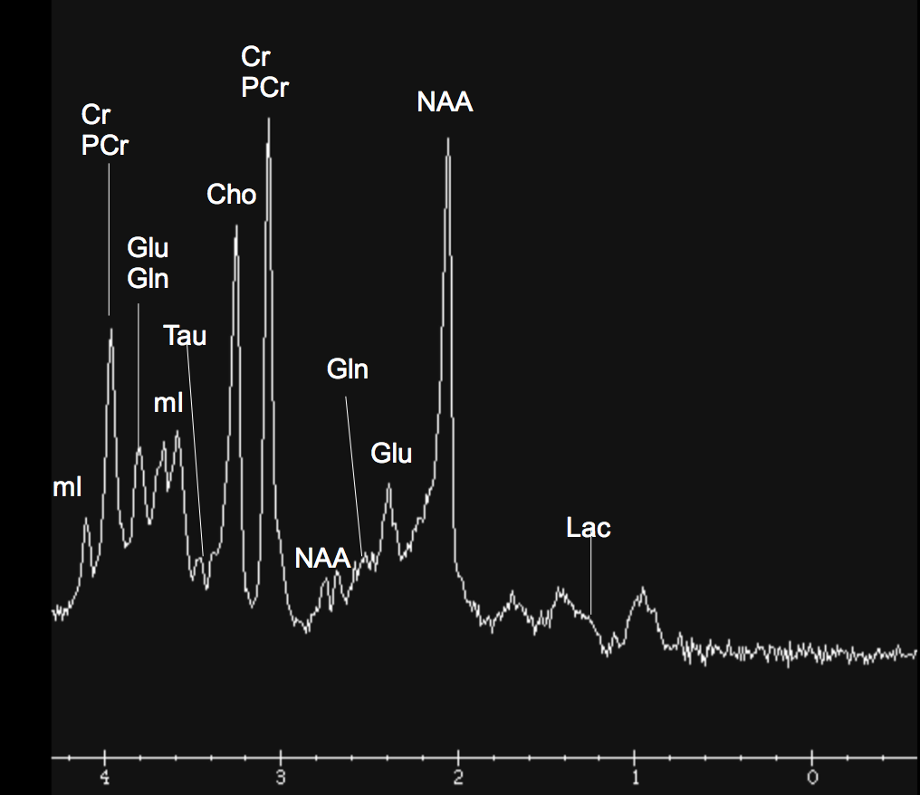
Reliability of 1H MRS Metabolites from the Cerebellar Vermis at 7T
Metabolite | Coefficient of Variation (CV)
Cho | 1.03
Cr+PCr | 2.77
NAA | 1.65
Glx | 1.31
Gsh | 0.79
mI | 1.18
Asp | 1.41
Tau | 3.27
Sequence from Ralph Noeske
Localizer + Cal + MRS = 8 minutes

Slide 12
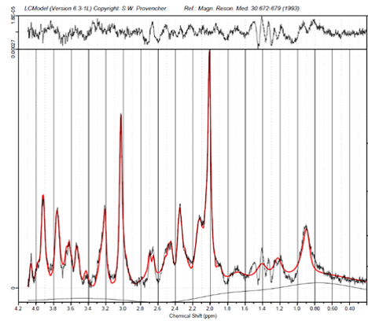
LCModel Analysis

Slide 13
³¹P Spectrum
Early MRS focused on phosphorus spectrum
Marker for cellular energy metabolism
Larger chemical shift 30ppm
Metabolites visible in spectrum
Adenosine triphosphate (ATP)
Adenosine diphosphate (ADP)
Phosphocreatine (PCr)
Inorganic phosphate (Pi)
Phosphodiester (PDE)
Phosphomonoester (PME)
Cellular energy metabolism
Membrane phospholipids

Slide 14
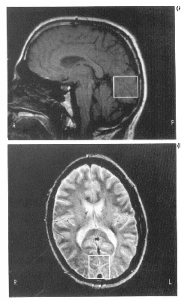
³¹P Studies
MR gold-standard for pH measures
Measure chemical shift between Pi and PCr
Frequency shift in Pi is dependent on pH and PCr is used as a reference
Low spatial and temporal resolution

Slide 15
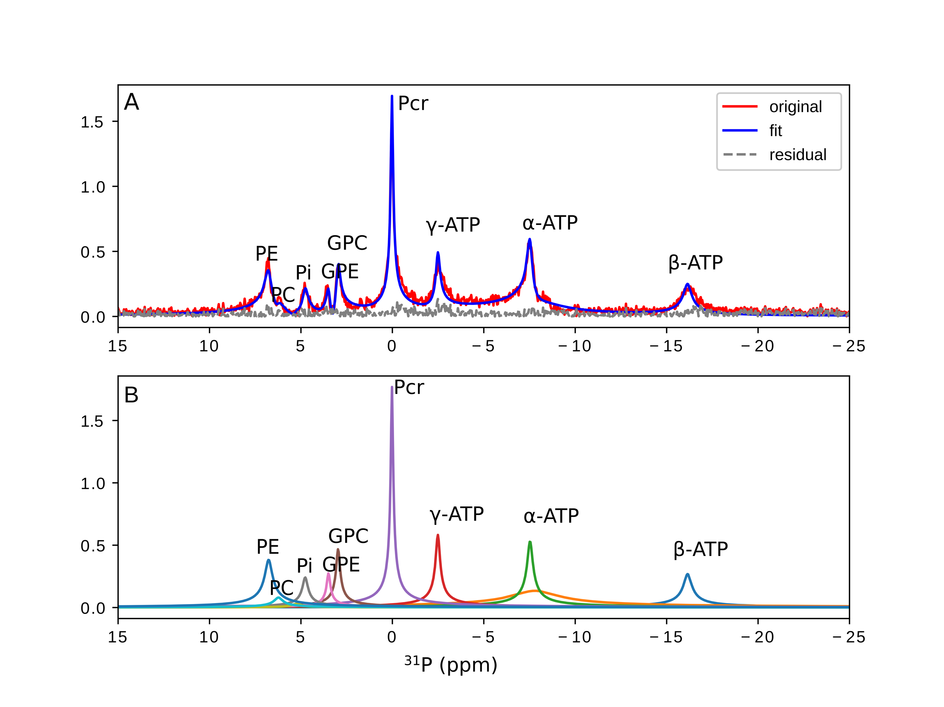
³¹P Brain Data
Peak | Coefficient of Variation (%)
 | HSVD | AMARES | Integration
γ-ATP | 4.9 ± 0.9 | 6.7± 2.4 | 4.1± 1.7
⍺-ATP | 5.3 ± 4.6 | 4.3 ± 1.1 | 3.6± 2.8
β -ATP | 2.1 ± 1.6 | 2.0 ± 0.8 | 1.3± 1.0
Work of Jia Xu

Slide 16
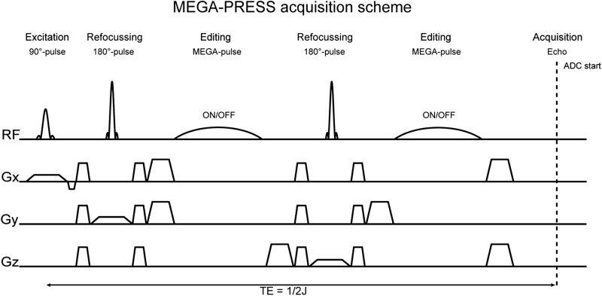
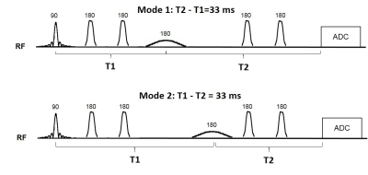
Editing Sequence

Slide 17
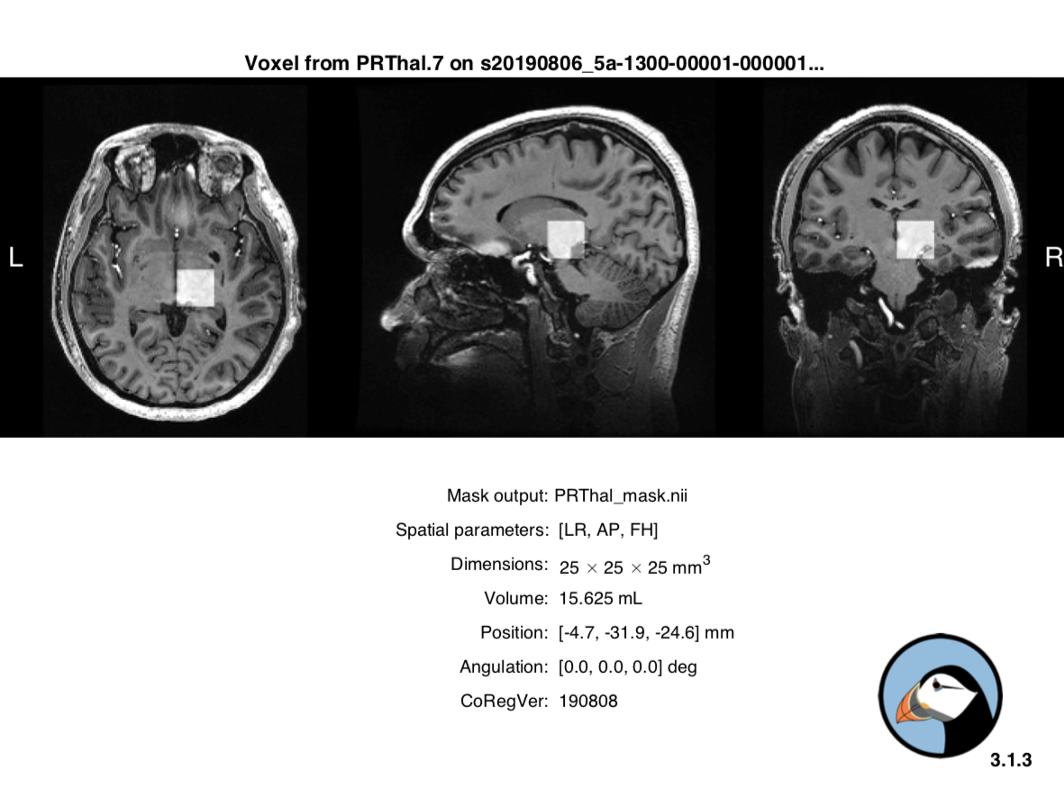
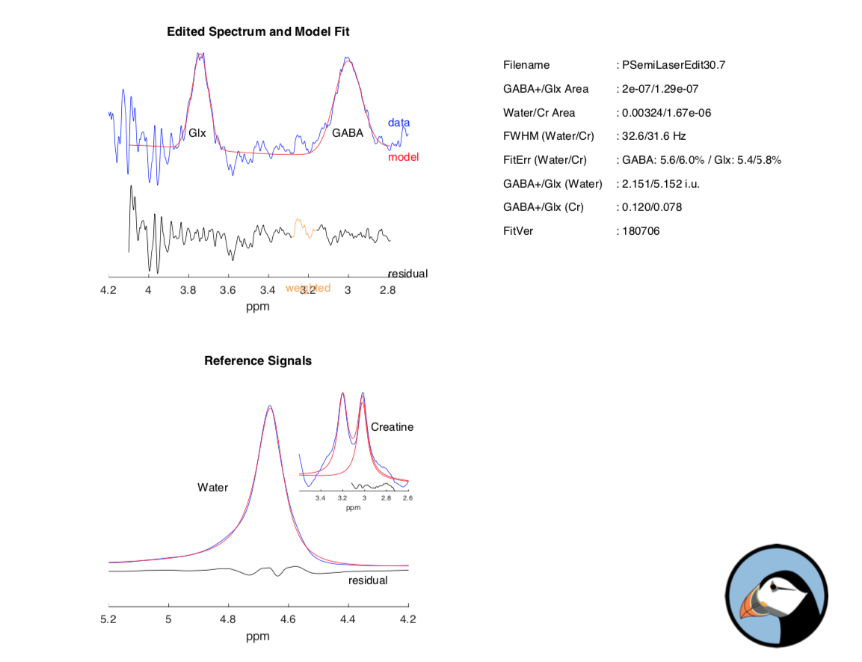
GABA Editing
Sequence from Ralph Noeske
Data from Chris Groth

Slide 18
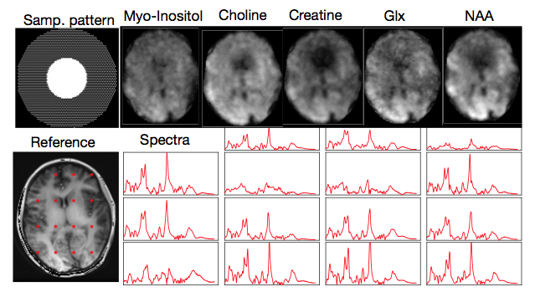
7T CSI Acquisition
Data from Mathews Jacob
Notes:
High resolution 2D CSI data collected on the GE MR950 7T scanner using a free induction decay (FID) CSI acquisition. Elliptical sampling used as shown in upper left. The resulting water image reconstructed from the data is shown in the lower left corner. The resulting metabolite maps are shown on the top row and the resulting spectra from the location marked with red squares are shown below.

Slide 19
Analysis Packages
LCModel – Industry standard from Provencher (¹H only)
JMRUI – Freely available (JAVA Based)
SIVIC - Freely Available
GANNET - GABA editing
TARQUIN
OXSA – Matlab based

Slide 20
